Slide 1
Software Construction & Development
Week 03
Naz Memon

Slide 2
What is Event-Driven Programming?
It is a programming paradigm in which the flow of a program is driven by events.
Event Handling
The Delegation Event Model
It defines standard and consistent mechanisms to generate and process events.
The Concept:
A source generates an event and sends it to one or more listeners

Slide 3
Event
An event is an object that describes a state change in a source.
An event can be generated as a consequence of a person interacting with the elements in a graphical user interface.
Pressing a button, entering a character via the keyboard, etc.
An event may also be generated when:
A timer expires
A counter exceeds a value
A software or hardware failure occurs
An operation is completed

Slide 4
Event Sources
A source is an object that generates an event.
Sources may generate more than one type of event.
A source must register listeners (why…?)
A listener register method looks like:
public void addTypeListener (TypeListener el )
Type = name of event
el = reference of the event listener

Slide 5
Event Sources
A source must also provide a method that allows a listener to unregister an interest in a specific type of event.
A listener unregister method looks like:
public void removeTypeListener(TypeListener el )
Type = name of event
el = reference of the event listener

Slide 6
Multicasting & Unicasting an Event
Multicasting:
When an event occurs, all registered listeners are notified and receive a copy of the event object.
Unicasting:
Some sources may allow only one listener to register. When an event occurs, the registered listener is notified.
These methods throw an exception when more than one listener try to connect to it.
Notes:
The methods that allow only one listener to register look like:
public void addTypeListener(TypeListener el ) throws java.util.TooManyListenersException

Slide 7
Event Listeners
A listener is an object that is notified when an event occurs.
It has two requirements:
Must be registered with one or more listeners
Must implement methods to receive and process
An event handler must return quickly, and must not maintain control for an extended period. (Why?)

Slide 8
Event Classes
The classes that represent events are at the core of Java’s event handling mechanism.
EventObject is a superclass of all events.
AWTEvent is a superclass of all AWT events that are handled by the delegation event model.

Slide 9
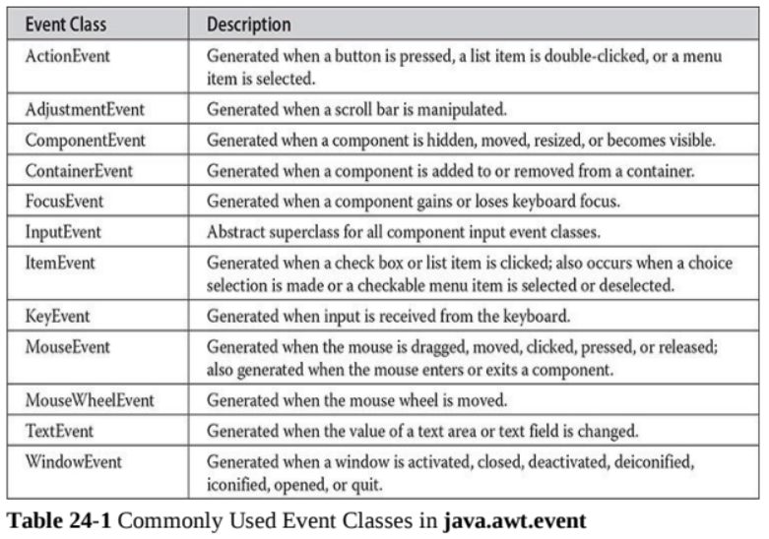

Slide 10
Event Classes
The ActionEvent Class
An ActionEvent is generated when a button is pressed, a list item is double-clicked, or a menu item is selected.
The AdjustmentEvent Class
An AdjustmentEvent is generated by a scroll bar.
The ComponentEvent Class
A ComponentEvent is generated when the size, position, or visibility of a component is changed.
The ContainerEvent Class
A ContainerEvent is generated when a component is added to or removed from a container.

Slide 11
Event Classes
The FocusEvent Class
A FocusEvent is generated when a component gains or loses input focus.
The InputEvent Class
The abstract class InputEvent is a subclass of ComponentEvent and is the superclass for component input events. Its subclasses are KeyEvent and MouseEvent.
The ItemEvent Class
An ItemEvent is generated when a check box or a list item is clicked or when a checkable menu item is selected or deselected.

Slide 12
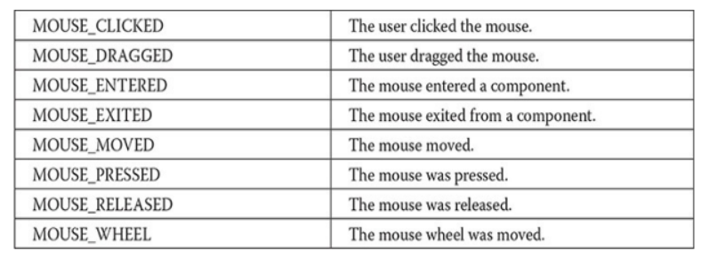
Event Classes
The KeyEvent Class
A KeyEvent is generated when keyboard input occurs. (KEY_PRESSED, KEY_RELEASED, KEY_TYPED)
The MouseEvent Class

Slide 13
Event Classes
The MouseWheelEvent Class
The MouseWheelEvent class encapsulates a mouse wheel event. It is a subclass of MouseEvent.
The TextEvent Class
Instances of this class describe text events. These are generated by text fields and text areas when characters are entered by a user or program.

Slide 14
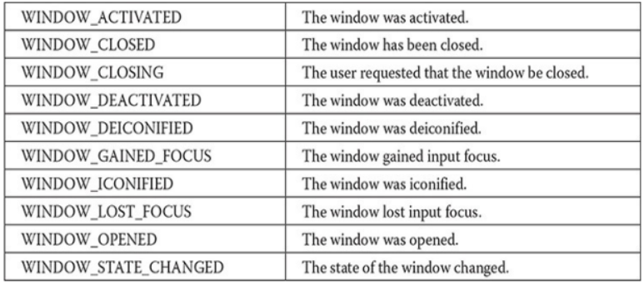
Event Classes
The WindowEvent Class

Slide 15
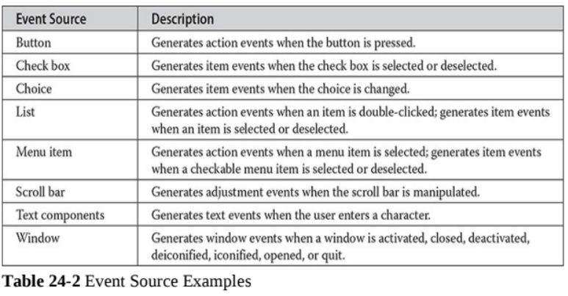
Sources of Events

Slide 16
Event Listener Interfaces
Listeners are created by implementing one or more of the interfaces defined by the java.awt.event package.
When an event occurs, the event source invokes the appropriate method defined by the listener and provides an event object as its argument.

Slide 17
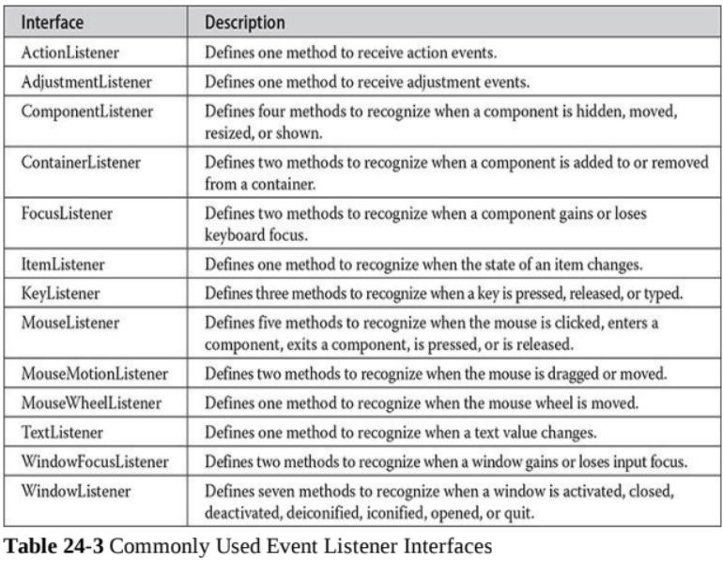

Slide 18
Examples
Mouse events & keyboard Events

Slide 19
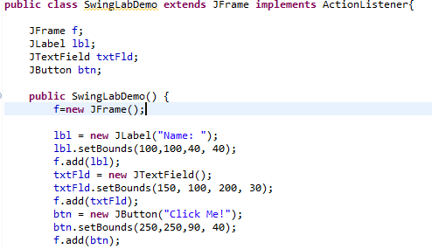


Slide 20
Adapter Classes
An adapter class provides an empty implementation of all methods in an event listener interface.
Why would we want Adapter Classes?
Adapter classes are useful when you want to receive and process only some of the events that are handled by a particular event listener interface.

Slide 21
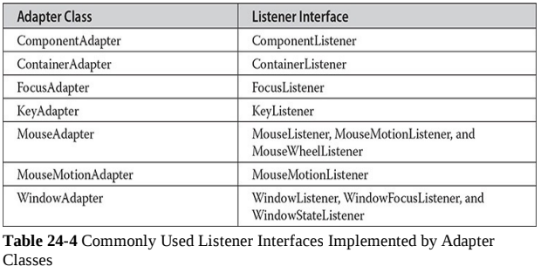
Adapter Classes

Slide 22
Example
Adapter Classes

Slide 23
Inner Classes
A class which is defined within another class, or within an expression.

Slide 24
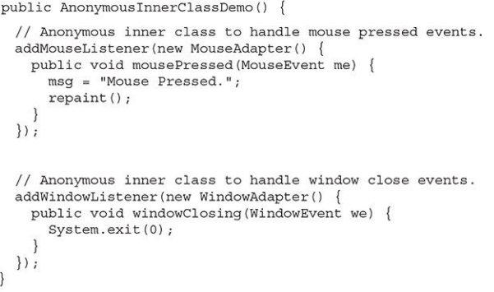
Anonymous Inner Classses
An anonymous inner class is an inner class that is not assigned a name
This is a constructor

